Slide 1

UNIT-I:
Software Development Process Models

Slide 2
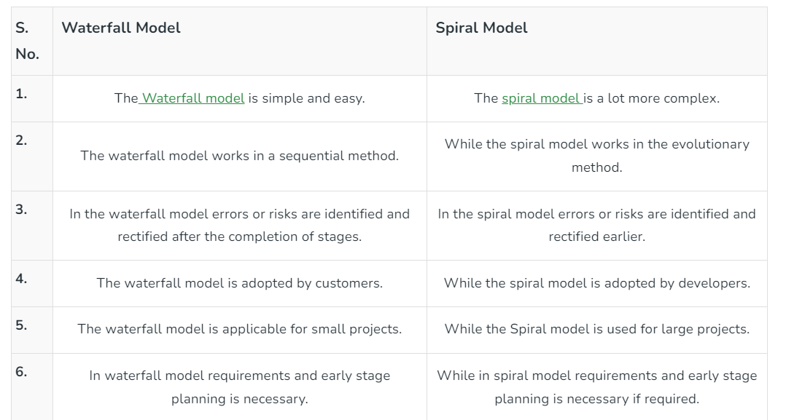
The Waterfall Model vs. The Spiral Model

Slide 3
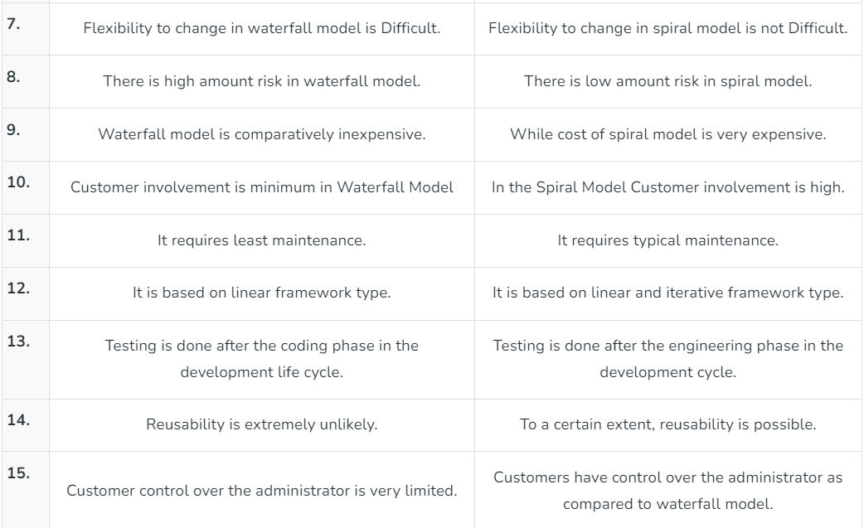

Slide 4

Agile Model

Slide 5
What is “Agility”?
Effective (rapid and adaptive) response to change (team members, new technology, requirements)
Effective communication among all team members, technological and business people, software engineers and managers
Drawing the customer into the team. Eliminate “us and them” attitude.
Organizing a team so that it is in control of the work performed!
Emphasize an incremental delivery strategy

Slide 6
Why and What
Why? The modern business environment is fast-paced and ever-changing.
A well-designed agile process may “flatten” the cost of change curve by coupling incremental delivery with agile practices Thus team can accommodate changes late in the software project without dramatic cost and time impact.

Slide 7
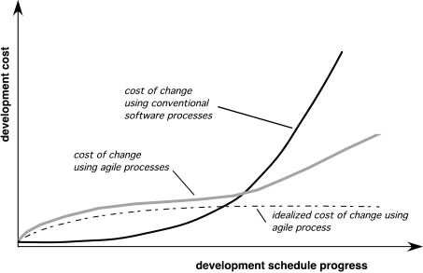
Agility and the Cost of Change

Slide 8

Agility Principles
1.Our highest priority is to satisfy the customer through early
and continuous delivery of valuable software.
2. Welcome changing requirements, even late in development.
Agile processes harness change for the customer's competitive advantage.
3. Deliver working software frequently, from a couple of weeks
to a couple of months, with a preference to the shorter timescale.
4. Business people and developers must work together daily
throughout the project. !
5. Build projects around motivated individuals. Give them the
environment and support they need, and trust them to get the job done.
6. The most efficient and effective method of conveying information to and within a development team is face–to–face conversation.

Slide 9

7. Working software is the primary measure of progress.
8. Agile processes promote sustainable development. The sponsors, developers, and users should be able to
maintain a constant pace indefinitely.
9. Continuous attention to technical excellence and good design enhances agility.
10. Simplicity – the art of maximizing the amount of work not done – is essential.
11. The best architectures, requirements, and designs
emerge from self–organizing teams.
12. At regular intervals, the team reflects on how to become more effective, then tunes and adjusts its behavior accordingly.

Slide 10

Human Factors
the process moulds to the needs of the people and team, not the other way around!
key traits must exist among the people on an agile team and the team itself:
Competence. ( talent, skills, knowledge)!
Common focus. ( deliver a working software increment )!
Collaboration. ( peers and stakeholders) !
Decision-making ability. ( freedom to control its own destiny) !
Fuzzy problem-solving ability.(ambiguity and constant changes, today problem may not be tomorrow’s problem)!
Mutual trust and respect.!
Self-organization. ( themselves for the work done, process for its local environment, the work schedule) !molds

Slide 11
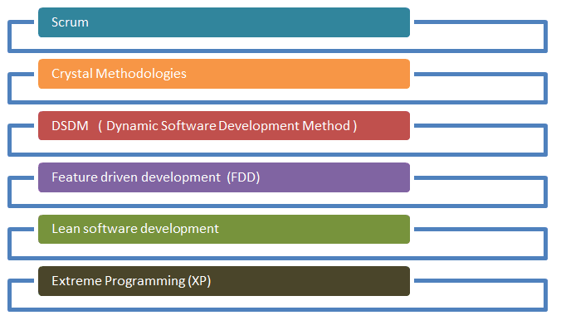
Agile methodologies

Slide 12
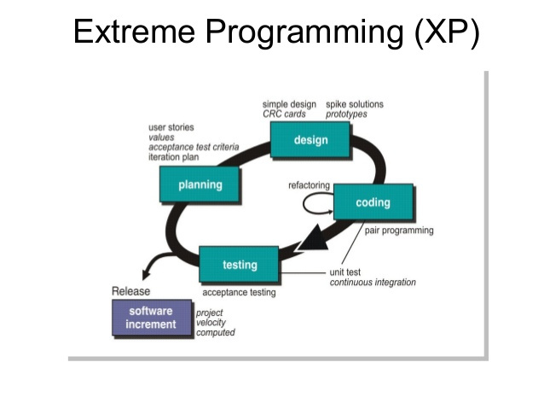

Slide 13
Extreme Programming (XP)!
The most widely used agile process, originally proposed by Kent Beck in2004. It uses an object-oriented approach. !
XP Planning
Begins with the listening, leads to creation of “user stories” that describes required output, features, and functionality. Customer assigns a value(i.e., a
priority) to each story.
Agile team assesses each story and assigns a cost (development weeks. If more than 3 weeks, customer asked to split into smaller stories)
Working together, stories are grouped for a deliverable increment next release.

Slide 14

A commitment (stories to be included, delivery date and other project matters) is made.
Three ways: 1. Either all stories will be implemented in a few weeks,
2. high priority stories first, or
3. the riskiest stories will be implemented first.
After the first increment “project velocity”, namely number of stories implemented during the first release is used to help define subsequent delivery dates for other increments. Customers can add stories, delete existing stories, change values of an existing story, split stories as development work proceeds.

Slide 15

Extreme Programming (XP)
XP Design ( occurs both before and after coding as refactoring is encouraged)
Follows the KIS principle (keep it simple) Nothing more nothing less than the story.
Encourage the use of CRC (class-responsibility-collaborator) cards in an object-oriented context- The only design work product of XP. They identify and organize the classes thatn are relevant to the current software increment
For difficult design problems, suggests the creation of “spike solutions”—a design prototype for that portion is implemented and evaluated. !
Encourages “refactoring”—an iterative refinement of the internal program design. Does not alter the external behavior yet improve the internal structure. Minimize chances of bugs. More efficient, easy to read. !

Slide 16

XP Coding!
Recommends the construction of a unit test for a story before coding commences. So implementer can focus on what must be implemented to pass the test. !
Encourages “pair programming”. Two people work together at one workstation. Real time problem solving, real time review for quality assurance. Take slightly different roles.
XP Testing
All unit tests are executed daily and ideally should be automated. Regression tests are conducted to test current and previous components.
“Acceptance tests” are defined by the customer and executed to assess customer visible
functionality!

Slide 17
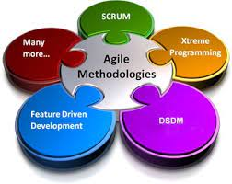

Slide 18
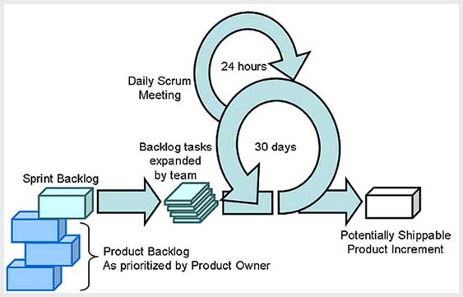

Slide 19

Description of the Object Oriented Analysis process vs. the Structure Analysis Model.
Analysis simple means to study or examine the structure of something, elements, and system requirements in detail, and methodical way. Structured analysis and Object-oriented analysis both are important for software development and are analysis techniques used in software engineering. But both are different from each other.
Structured Analysis and Object-Oriented Analysis (OOA) are two software development methodologies that are used to design and develop software systems. While they have some similarities, they differ in a number of key ways.
Structured Analysis:
Focus on processes: Structured Analysis focuses on the processes involved in a software system, modeling them as a series of connected steps.
Top-down approach: Structured Analysis follows a top-down approach, breaking down complex systems into smaller, simpler parts that can be more easily understood.
Data-centered: Structured Analysis focuses on the data that a software system manipulates, modeling it as data flows between processes.
Emphasis on functional decomposition: Structured Analysis emphasizes the functional decomposition of a software system into smaller, independent functions.

Slide 20

Object-Oriented Analysis (OOA):
Focus on objects: OOA focuses on the objects involved in a software system, modeling them as instances of classes that encapsulate both data and behavior.
Bottom-up approach: OOA follows a bottom-up approach, building complex systems from smaller, simpler objects that can be more easily understood.
Object-centered: OOA focuses on the objects that make up a software system, modeling their relationships and interactions.
Emphasis on object-oriented design patterns: OOA emphasizes the reuse of objects and object-oriented design patterns, reducing the amount of code that needs to be written and improving the quality and consistency of the software.
In conclusion, Structured Analysis and OOA are both valuable software development methodologies, each with its own strengths and weaknesses. The choice of which to use depends on the particular requirements and constraints of a software project.

Slide 21
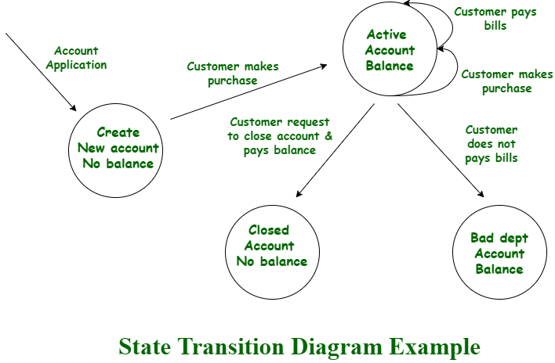
1. Structured Analysis : Structured analysis is a method of development that allows and gives permission to the analyst to understand and know about the system and all of its activities in a logical way. It is simply a graphic that is used to specify the presentation of the application.
Example –

Slide 22
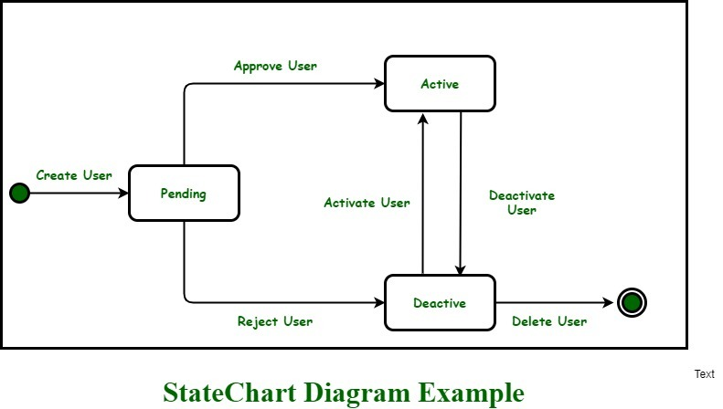
2. Object-Oriented Analysis :
Object-Oriented Analysis (OOA) is a technical approach generally used for analyzing and application designing, system designing, or even business designing just by applying object-oriented programming even with the use of visual modeling throughout the process of development to just simply guide the stakeholder communication and quality of the product. it is a process of discovery where a team of developers understands and models all the requirements of the system.
Example –

Slide 23
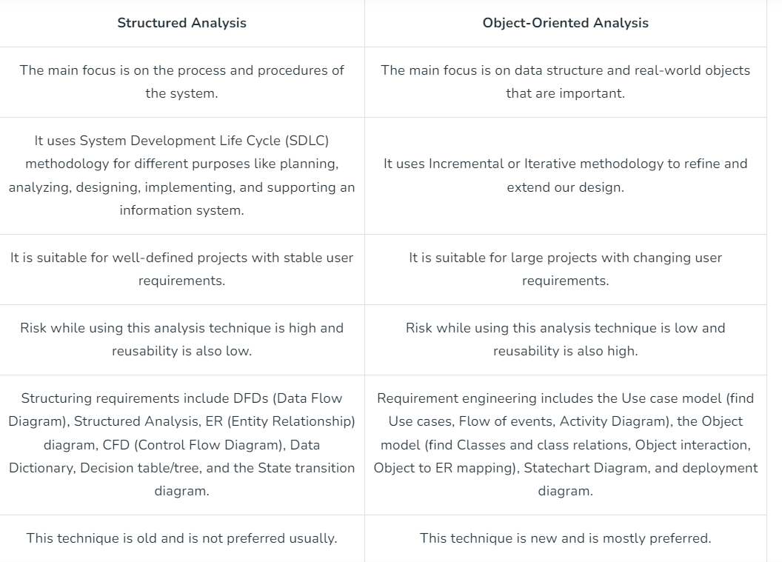

Slide 24
Advantages of Structured Analysis:
Clear and straightforward:
Top-down approach:
Emphasis on data:
Well-suited for small to medium-sized systems:
Disadvantages of Structured Analysis:
Limited scalability:
Lack of object orientation:
Limited ability to model complex relationships
Advantages of Object-Oriented Analysis (OOA):
Reusable code:
Scalability:
Object orientation:
Better modeling of complex relationships
Disadvantages of Object-Oriented Analysis (OOA):
Steep learning curve:
Bottom-up approach:
Emphasis on objects:

Slide 25

Characteristics of Objects
They have unique identity.
They fall into categories, or classes.
They fall into hierarchies or aggregations.
They have well defined behaviors & responsibilities.
They separate interface from implementation.
They hide their internal structures.
They have state.
They provide services.
They send messages to other objects.
They receive messages from other objects, and react appropriately.
They delegate responsibilities to other objects

Slide 26
The Procedural /structural Approach
System is organized around procedures.
Procedures send data to each other.
Procedures and data are clearly separated.
Focus on data structures, algorithms and sequencing of steps.
Procedures are often hard to reuse.
Lack of expressive and powerful visual modeling techniques.
Transformation of concepts between analysis & implementation.
This programming paradigm is essentially an abstraction of machine / assembly language.
Design models are a long step from implementation

Slide 27

Why ‘Object-Oriented’? OO methods make it easier to build systems that: – solve the right problem – work properly – are maintainable – are extensible – are reusable. Many people find OO easier to comprehend. The implementation can be less complex. Union of data and function is natural. Smaller conceptual gap between analysis and implementation.

Slide 28
Why ‘Object-Oriented’?
A well-designed set of objects is resilient to reuse and change.
Visual models offer more efficient communication.
The modeling process helps create a common vocabulary and shared understanding between developers and users / clients.
You don’t need to be a computer programmer to understand an object model.
You can make more $$$ -
Objects allow all of these benefits, but do not provide them.

Slide 29
Modelling Successful programs solve problems in the real world.
They correspond closely to the real world problems they solve.
They model the problem domain and users’ activities.
Modelling enables better communication and visualization for all stakeholders.
Successful OO designs almost always begin with a visual “object model” of the problem domain, involving both the domain experts and software designers alike.
Would you let a contractor build your new house without blueprints

Slide 30

The Object-Oriented Approach
System is organized around objects.
Objects send messages (procedure calls) to each other.
Related data and behavior are tied together in objects.
Modeling of the domain as objects so that the implementation naturally reflects the problem at hand.
Visual models are expressive and relatively easy to comprehend.
Focus on responsibilities & interfaces before implementation.
Powerful concepts: interfaces, abstraction, encapsulation, inheritance, delegation & polymorphism.
Visual models of the problem evolve into models of the solution.
Design models are only a small step from implementation

Slide 31

Modeling
Successful programs solve problems in the real world.
They correspond closely to the real world problems they solve.
They model the problem domain and users’ activities.
Modeling enables better communication and visualization for all stakeholders. Successful OO designs almost always begin with a visual “object model” of the problem domain, involving both the domain experts and software designers alike.
Would you let a contractor build your new house without blueprints?

Slide 32

Objects
Represent real or abstract things, with a name.
Have well-defined responsibilities.
Exhibit well-defined behavior.
Have a well-defined interface, which is as simple as possible.
Are self-consistent, coherent, and complete.
Are (usually) not very complex or large.
Have knowledge of themselves and the interfaces of a small number of other objects.
Are “team players” with a small number of other objects. l Are as loosely coupled with other objects as possible.
Are well documented, so that others may (re)use them

Slide 33
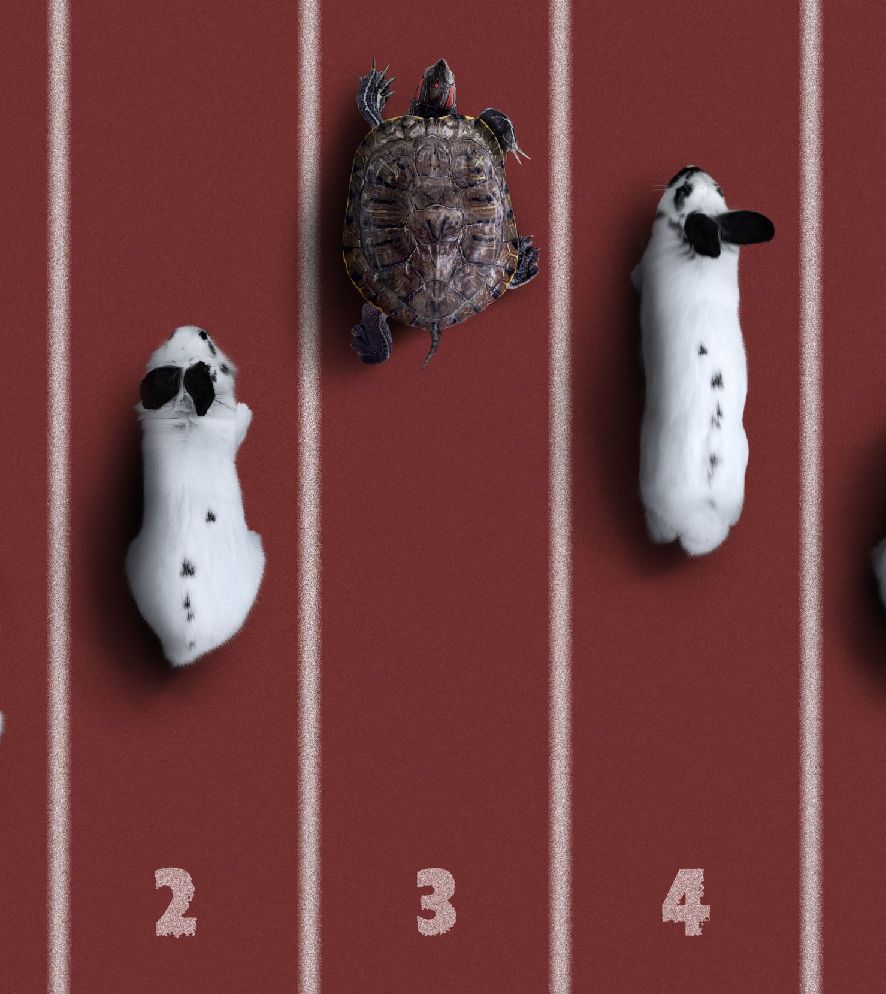
Objects are instances of classes, each with a unique identity.
l A class defines both the interface(s) and the implementation for a set of objects, which determines their behavior.
l Abstract classes are classes that can have no instances.
l Whenever there is an Abstract classes such as Pet, there are usually some derived concrete classes such as Dog & Cat, which can be instantiated.
l Some OO languages (such as Smalltalk) support the concept of a metaclass, which allows the programmer to define a class on-thefly, and then instantiate it. In this case, the class is an object, whose class is the metaclass

Slide 34
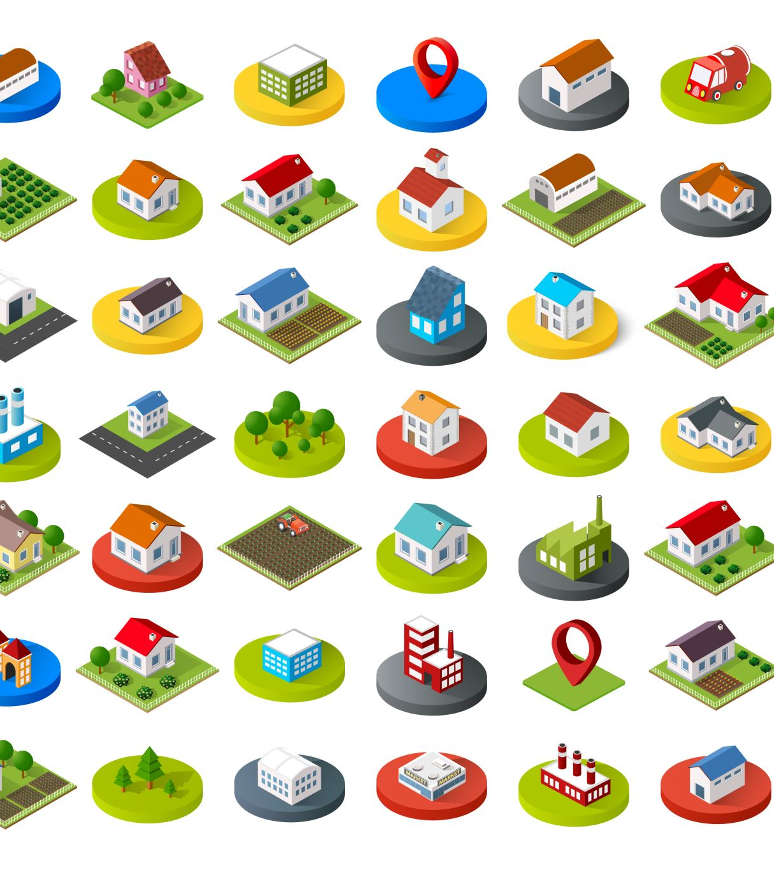
Classes
A collection of objects, sharing common attributes and behaviors. The classification(s) of a collection of objects often depends on the attributes in which you are interested.
Examples: streets, roads, and highways... Different programs would classify these differently...
Traffic simulator: – one-way, two-way, divided, residential, limited access. – location w/ respect to business commuters.
Maintenance scheduler: – surface material. – heavy truck traffic. – location w/ respect to congressional district.

Slide 35

Classes, cont.
Classes are objects too
A class can have attributes – An Employee class may have a list of all its instances – A LotteryTicket class may have a seed it uses to generate random ticket numbers.
A class can have behaviors – An Employee class may have a getEmployeeBySerialNum behavior – A LotteryTicket class may have a generateRandomNumber behaviour.

Slide 36

Encapsulation
Exposing only the relevant details: the public interface. What? not How?
Hiding the “gears and levers”.
Exposing only the client’s view of the object’s responsibilities.
Protects the object from outside interference.
Protects other objects from relying on details that are likely to change.
Information hiding promotes loose coupling between objects and modularity, which promotes flexible design, and reusability.
Reduces interdependencies in the code.
“Good fences make good neighbors”. Example: Your car’s gas peda

Slide 37

Inheritance
Inheritance is a way of describing a class by saying how it differs from another class. – Example: “Class Y is like Class X except for the following differences… ”
Why use inheritance? – When you have two types where one is necessarily an extension of the other.
– Sometimes (but not all the time) you are going to want to ignore the differences and look only at the what they have in common (the base class). This is called generalization.
Consider a system that can manipulate various kinds of shapes (the classic example): – Sometimes you don’t care what particular kind of shape you have (example: move to a different location). – Sometimes you do care (example: draw the shape on a display).

Slide 38
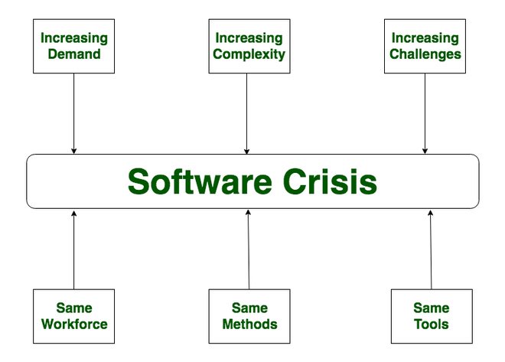
Software Crisis
Software Crisis is a term used in computer science for the difficulty of writing useful and efficient computer programs in the required time. The software crisis was due to using the same workforce, same methods, and same tools even though rapidly increasing software demand, the complexity of software, and software challenges. With the increase in software complexity, many software problems arise because existing methods were insufficient.
If we use the same workforce, same methods, and same tools after the fast increase in software demand, software complexity, and software challenges, then there arise some issues like software budget problems, software efficiency problems, software quality problems, software management, and delivery problems, etc. This condition is called a Software Crisis.

Slide 39
Causes of Software Crisis:
The cost of owning and maintaining software was as expensive as developing the software.
At that time Projects were running overtime.
At that time Software was very inefficient.
The quality of the software was low quality.
Software often did not meet user requirements.
The average software project overshoots its schedule by half.
At that time Software was never delivered.
Non-optimal resource utilization.
Challenging to alter, debug, and enhance.
The software complexity is harder to change.
Factors Contributing to Software Crisis:
Poor project management.
Lack of adequate training in software engineering.
Less skilled project members.
Low productivity improvements.

Slide 40

Solution of Software Crisis:
There is no single solution to the crisis. One possible solution to a software crisis is Software Engineering because software engineering is a systematic, disciplined, and quantifiable approach. For preventing software crises, there are some guidelines:
Reduction in software over budget.
The quality of the software must be high.
Less time is needed for a software project.
Experienced and skilled people working on the software project.
Software must be delivered.
Software must meet user requirements.

Slide 41
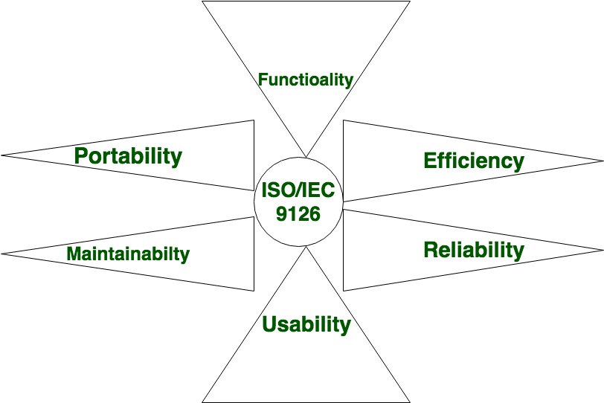
Quality Software Characteristics –
Software Engineering

Slide 42
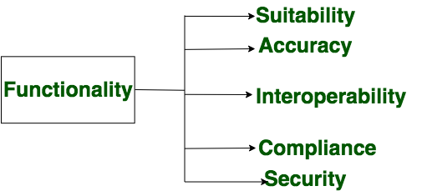
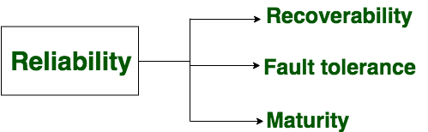
Components of Software Characteristics:
Examples of functionality in software include:
Data storage and retrieval
Data processing and manipulation
User interface and navigation
Communication and networking
Security and access control
Reporting and visualization
Automation and scripting
Examples of factors that can affect the reliability of software include:
Bugs and errors in the code
Lack of testing and validation
Poorly designed algorithms and data structures
Inadequate error handling and recovery
Incompatibilities with other software or hardware

Slide 43
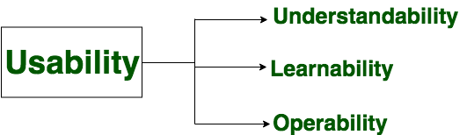
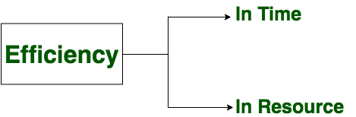
It refers to the extent to which the software can be used with ease. the amount of effort or time required to learn how to use the software.
Examples of factors that can affect the efficiency of the software include.
Poorly designed algorithms and data structures
Inefficient use of memory and processing power
High network latency or bandwidth usage
Unnecessary processing or computation
Unoptimized code

Slide 44
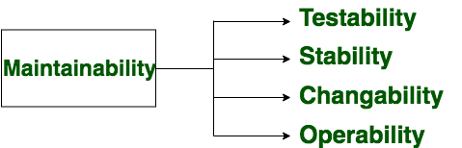
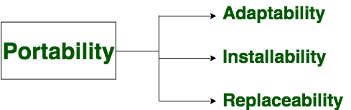
It refers to the ease with which modifications can be made in a software system to extend its functionality, improve its performance, or correct errors.
A set of attributes that bears on the ability of software to be transferred from one environment to another, without minimum changes.

